Slide 1

Staatsbibliothek zu Berlin – PK
Is this really relevant? Browser-based Testing for Enhancing Search results collaboratively
Paterson / Kaufmann
Notes:
Konkreter Eindruck, wie ich damit arbeite; Vorteile / Nachteile

Slide 2

Introduction
Duncan Paterson (duncdrum)
1 year Subject Librarian for Taiwan, Hong Kong, China at day
15+ years of FOSS development and maintenance at night
0.5 years PO for CrossAsia Search (launch 2024) of Specialised Information Service Asia (FID Asien)
One of three productive instances at Stabi Berlin
Annette Kaufmann

Slide 3

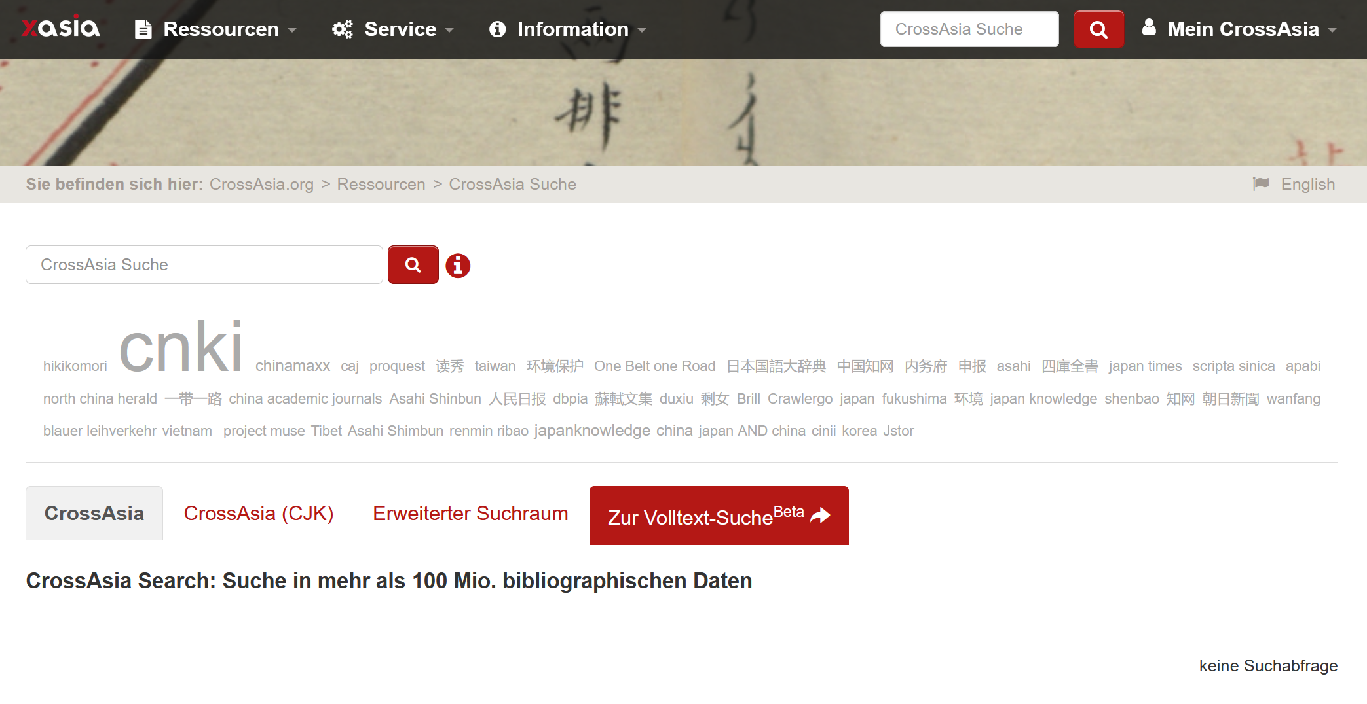

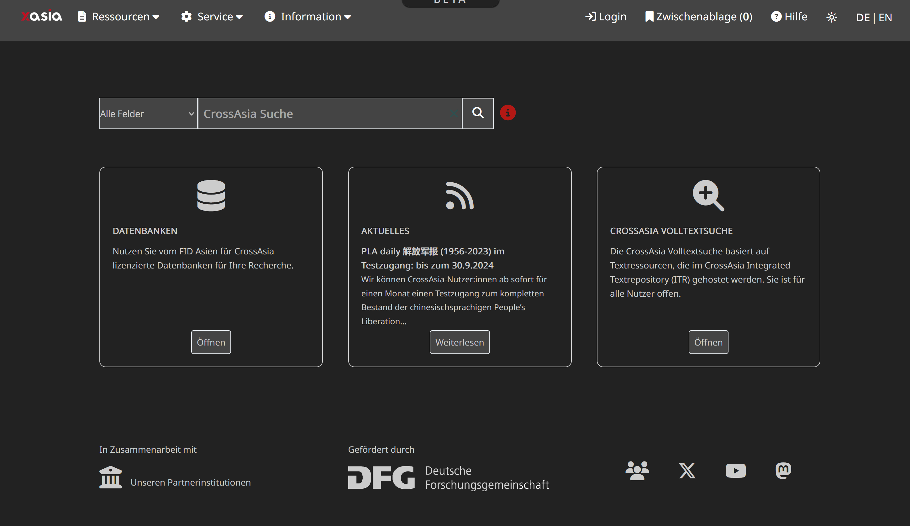
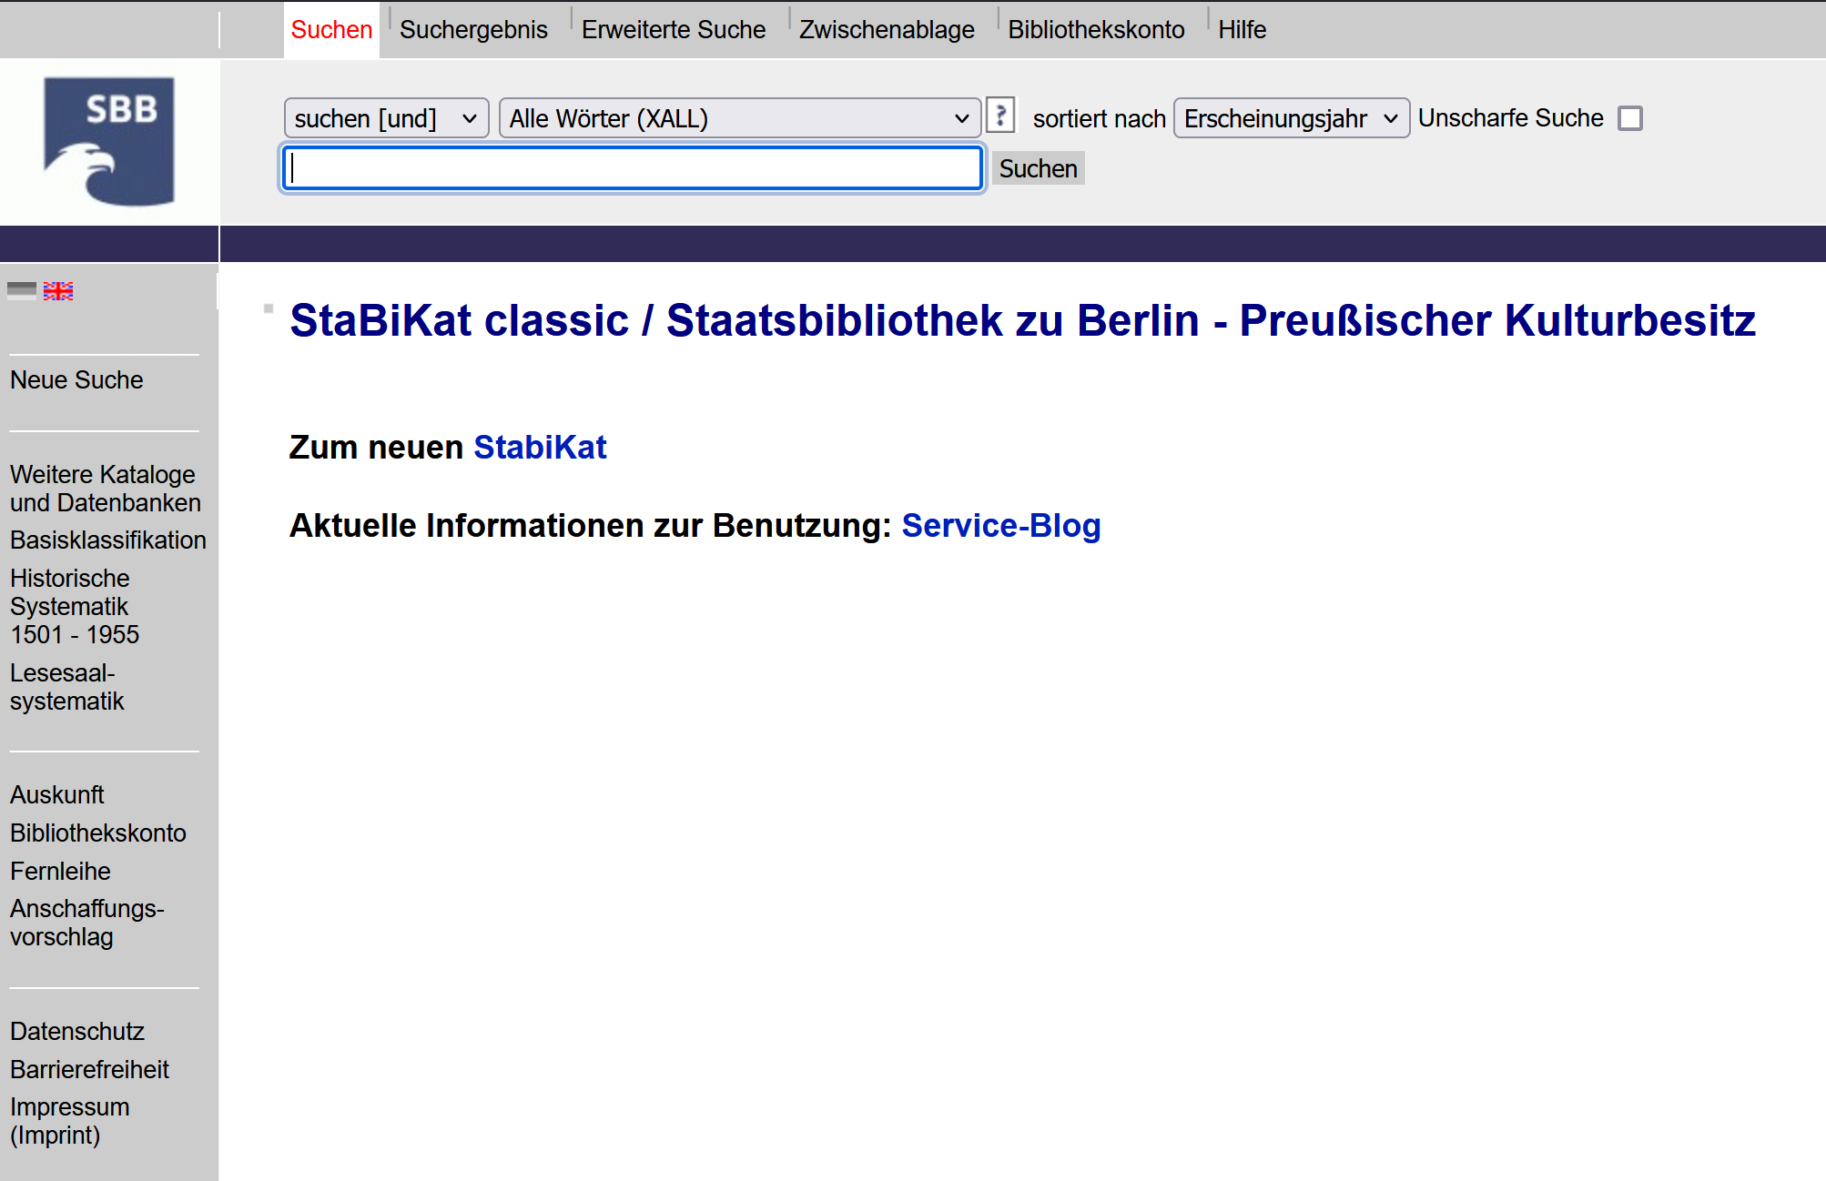
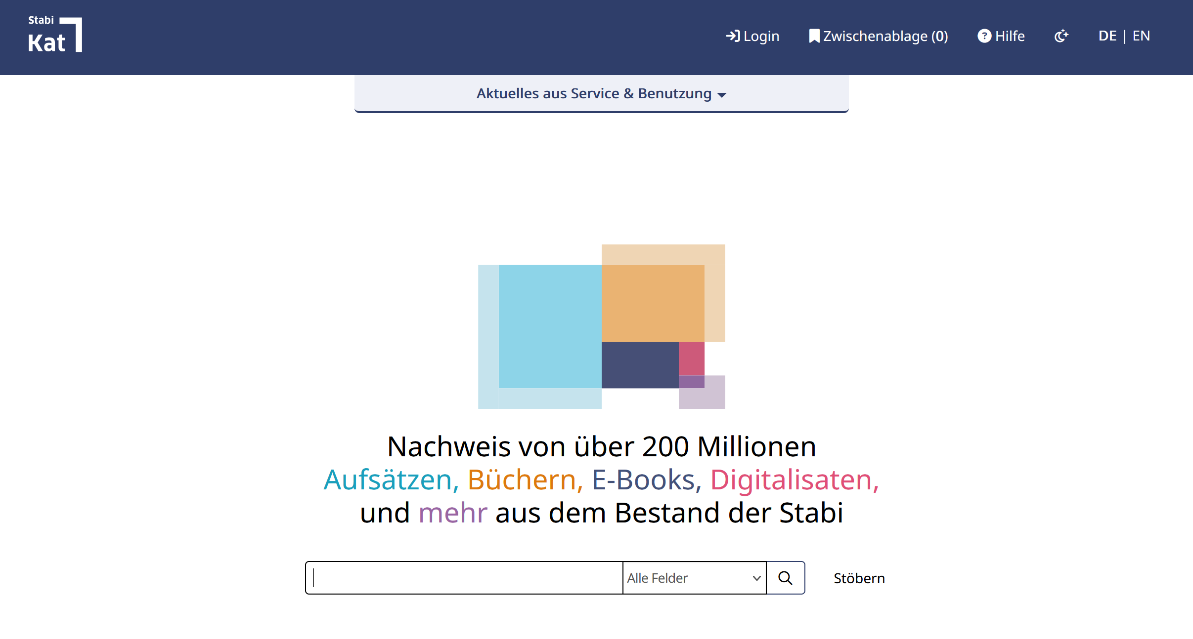
How did we get here?
Notes:
Not talking about inherent biases of relevancy rankings or some such

Slide 4

… they worked without a glitch…
Where is my stuff ¡?
I could see this in the old system
… everybody happy
I can’t find articles
Too many articles
This is different

Slide 5
How do we fix it?
Data
Vufind
Index
Three instances
Three usergroups
Many stakeholders
Reader Services
IT
Infrastructure
East Asia
Law
…
This we can tweak
Collaborative Index K 10 Plus
Configuration is not under our control
Legacy Data
Heterogenous Sources
Changes can carry high cost
☒
🗹
☒

Slide 6
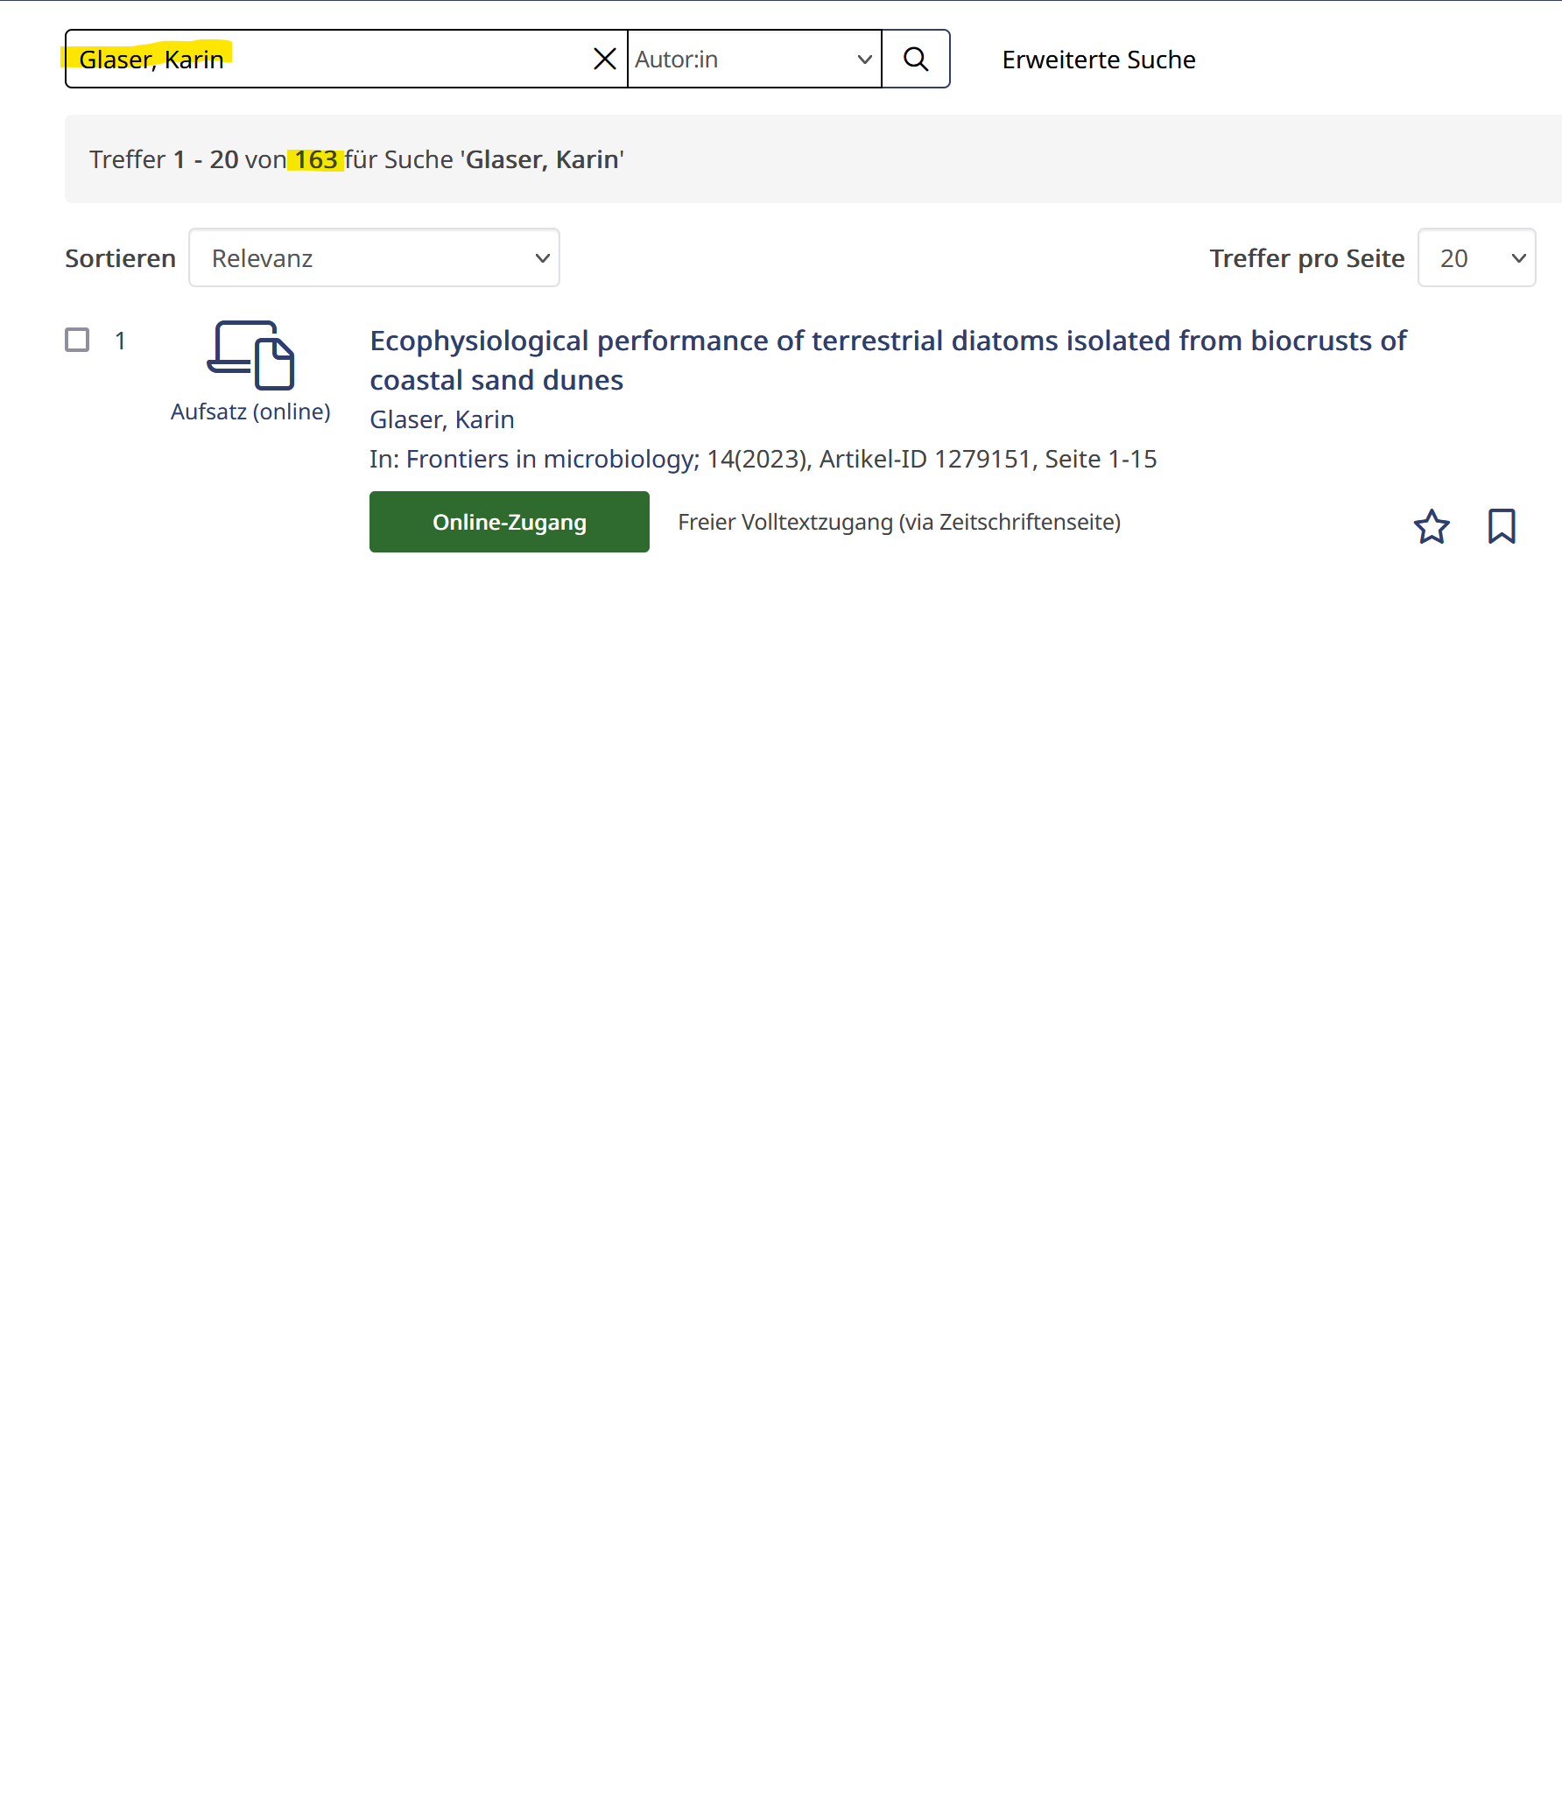
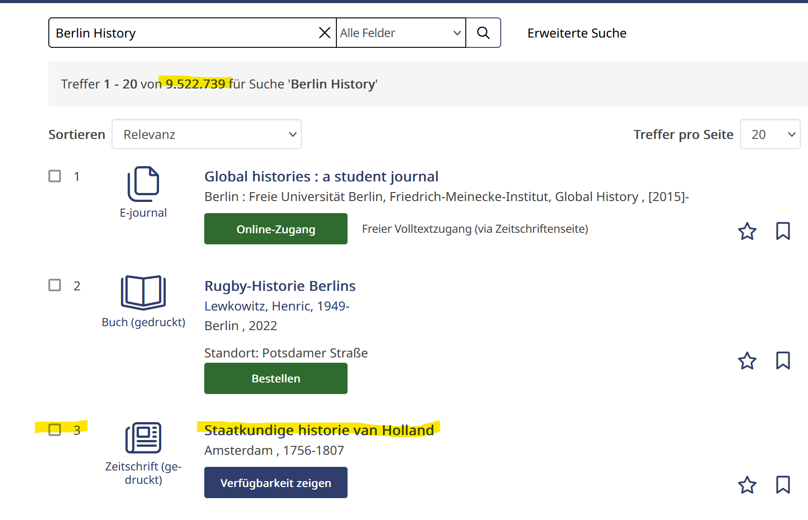

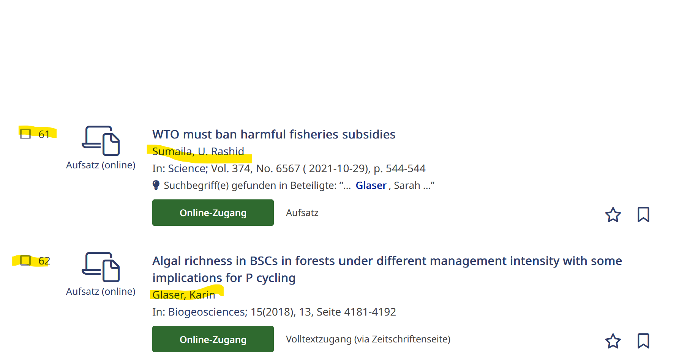
Our users should find stuff
Notes:
The spreadsheet
Super Annette
Users Domain Experts nad Devs

Slide 7
The Solutions
1 person
80 queries
No reproducers
Whoever screams loudest or hardest wins
Notes:
Super Annette will fix it

Slide 8
What are we using
Github Desktop
Cypress
GitHub Actions
Linting
Test Server

Slide 9
How it works
Tags
Tests against prod and local
Transparency
Avoid Regressions

Slide 10
What kind of Problems
Translation
Chronology
Author

Slide 11


Working With Git and Cypress for the First Time (as a Librarian): This is awesome!
don‘t have to do it all alone!
I can actually see (side) effects!
can travel back and forth in time!
all versions of yaml are safe!
this is all very exiting!
"Rudi ist begeistert" by stanzebla is licensed under CC BY-SA 2.0.
Notes:
Alone meaning: run 80 search queries manually and compare all (!!!) of the result lists to see what has changed and check for side effects. -> not possible! The complexity is baffling (at least to me)
Versionizing the yaml and how to handle it was an unsolved issue: only idea was saving the yaml after each change….. Which I‘m aware probably sounds ludicrous to this audience….
Plus I was really eager to enter the mysterious realm of Git and kinda „graduate“ to more developer-like work process.

Slide 12
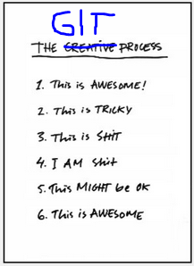

Test-Driven Development as a Newbie (and Librarian): This is Tricky IT Stuff
installation: couldn‘t have done it alone
performance: tests are kinda slow
tests: understanding and adding (I don‘t speak Javascript)
and, the biggie: Git: getting my head around workflow and branches-multiverse; getting lost time and again
Cypress: wait, what? Reading test results
Notes:
Circling through the stages (see right) on a regular basis
3 Fragen: Was hat‘s mir gebracht (This is aswesome)
Wie arbeit ich damit?
Wo hörts auf? (Tests schreiben, die über copy&paste + anpassung hinausgehen: yaml: komplexere Funktion „wenn, dann“ complex boost functions (Extra Folie)
Mehr Folien von den Oberflächen / der yaml
Message: if you‘re administrator you need to support getting started and teach Git; and permanent support;

Slide 13



Test-Driven Development as (a Newbie) and Librarian: This is … … tricky Culture Clash
automated tests versus manual searches
test results versus interpretation of hit lists
trust in the process?
capacity for interest / understanding?
ranking visualisation would be helpful to breech this AND for users, of course
usability research to synch development with users‘ needs
decisions regarding ranking demands
"Good versus Evil" by kosmolaut is licensed under CC BY 2.0.
Notes:
Before: manual searches and interpretation of hit lists : personal, „intellecutal“, seems more „hands-on“, controllable, reproducible and traceable – it‘s what librarians are used to.
Automated tests and looking at green checks and red crosses by comparison seems technocratic, like loss of control and kind of externalised. I don‘t feel there‘s trust in the tests doing their job
While in effect it‘s the other way round. Having studied language and literature this seems to me like the divide between humanities and science all over again.
Failure to get across the advantages, nay: the NECESSITY for test-based ranking development: 82 search queries
Side effects seem not to be differentiated from work to fulfill ranking demands.
Teaser: talk about user feedback-driven development of our discovery system tomorrow 3 pm (sorry, in German)
No discernable decision process in place (as far as I see)
Big Issue: Präzisierung: Anforderung; Reproducible (-> Duncan)

Slide 14
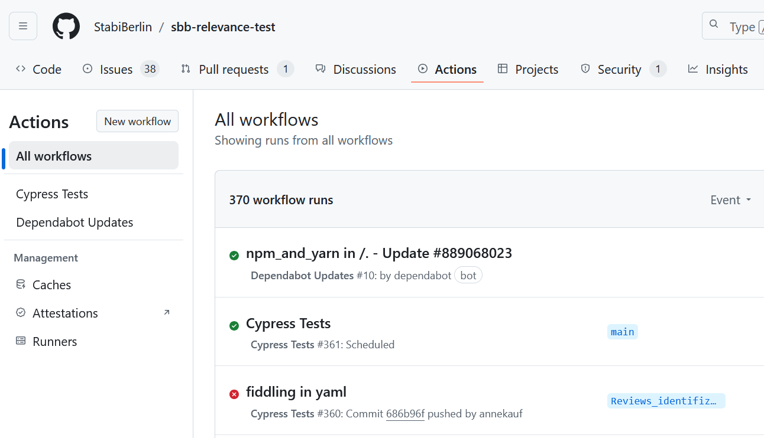
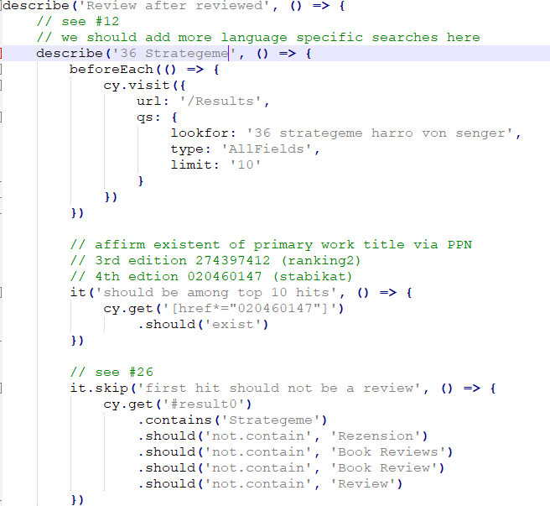

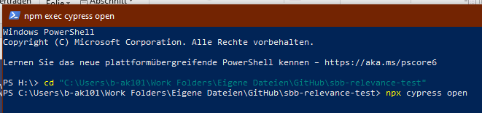
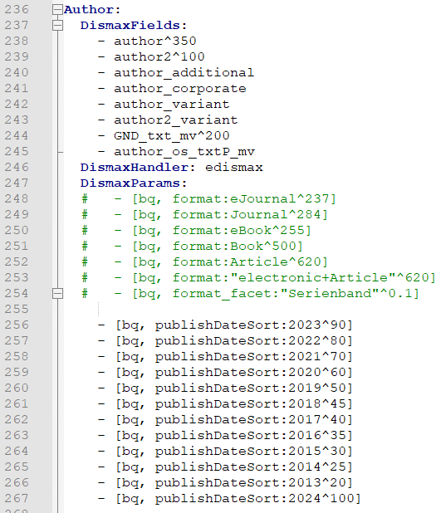
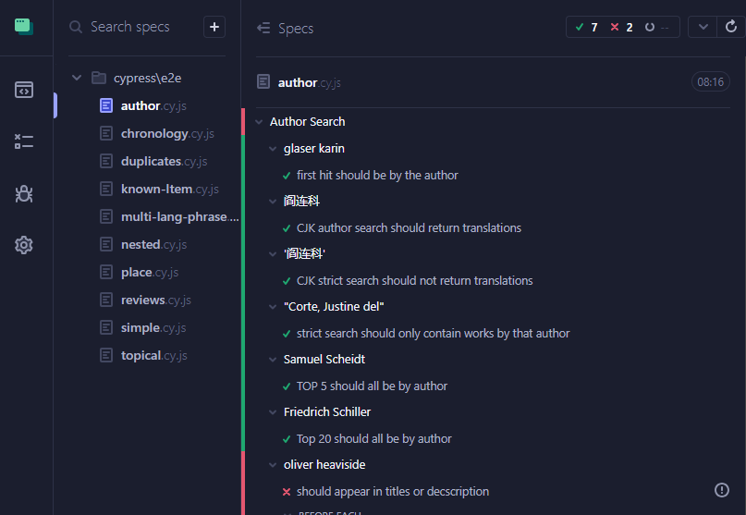
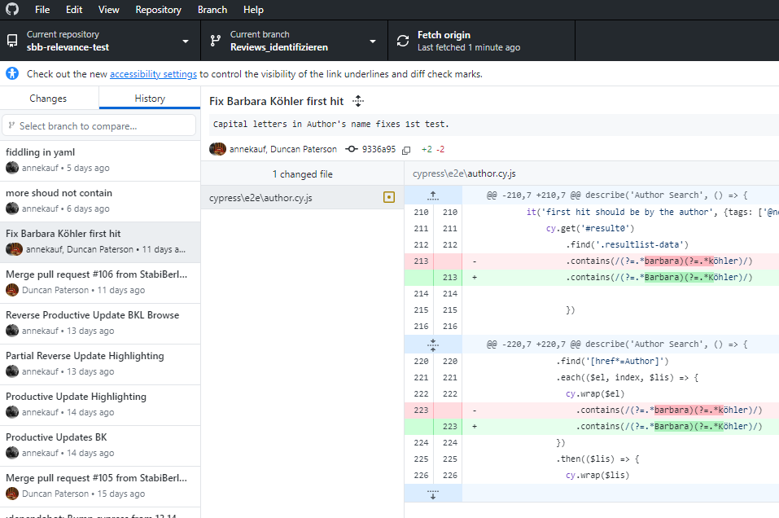
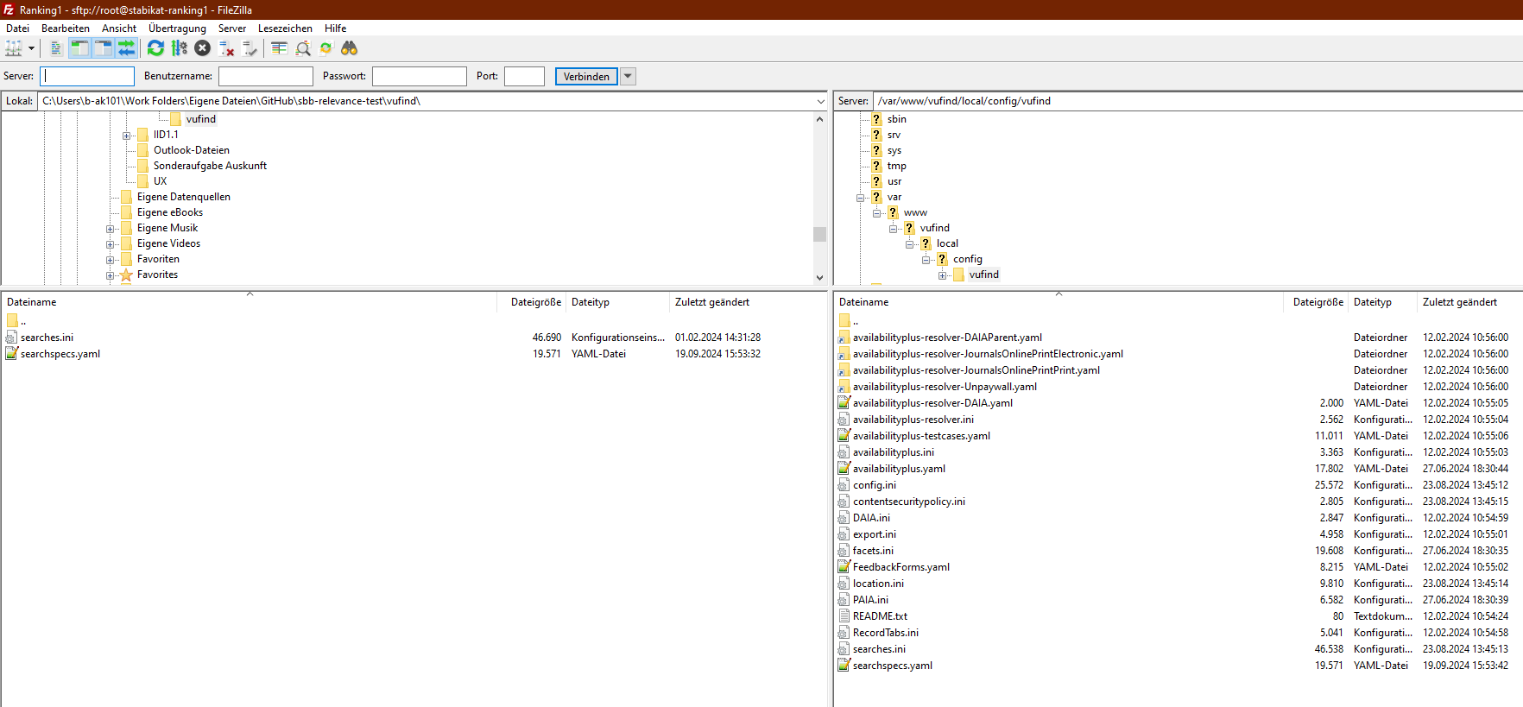
Working With Git and Cypress for the First Time (as a Librarian): I am … … confused
"Shock Shock Horror Horror" by Jeremy Brooks is licensed under CC BY-NC 2.0.
Notes:
Github, GitDesktop, Filezilla, Cypress, yaml, tests (javascript), powershell, how to handle regressions, how to work through the complexity?, why can‘t I switch branches, what happened to this commit….

Slide 15
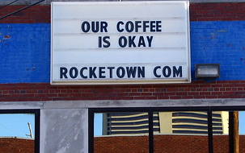
Test-Driven Development as a Newbie (and Librarian): This Might be Okay
managing expectations: what yaml can and can‘t solve re: VuFind result list
getting to grips with Git (more or less)
explaining work process to colleagues
„comes at a price“
there‘s no such thing as a perfect yaml = perfect ranking: be happy with an ok ranking
"Our Coffee is Okay" by SeeMidTN.com (aka Brent) is licensed under CC BY-NC 2.0.
Notes:
Yaml can‘t solve duplicate problems; can‘t solve „wrong authors“ in result list („Barbara Köhler“) ; hard to have chronology ranking and at the same time disciminate reviews (Review problem / UX)
-> comes at a price; yaml is not a jack-of-all-trades device

Slide 16
Working With Git and Cypress for the First Time (as a Librarian): This is awesome!
have learned so much!
don‘t have to do it all alone!
travel back and forth in time!
all versions of yaml are safe!
can actually see (side) effects!
track progress accurately
"Rudi ist begeistert" by stanzebla is licensed under CC BY-SA 2.0.
Notes:
It was the biggest competence gain in my last 3 working years.
New on this slide: tracking of progress

Slide 17

Git Frontier (to be pushed forward in the future?)
writing tests from scratch / Javascript
yaml: writing complex boost functions
could I install a new repo on my own?
tech support (am still not very saddle-proof in Git): can I ask IT department?
few librarian colleagues work with Git – makes transfer to other contexts difficult
"c'era una volta il west.....once upon a time in the west...." by betbele is licensed under CC BY-NC-SA 2.0.
Notes:
Alas, I‘m no programmer, so…
Alas, there‘s – to my experience so far – quite a divide between IT department and librarian work, and doing this has only showed this breech more promimently for me - note that all my support stands right next to me, and he‘s doing it out of the goodness of his heart – it‘s beyond his job despription. And it‘s quite by chance that we got to know each other. In the ususal course of working things our paths would never have crossed.

Slide 18
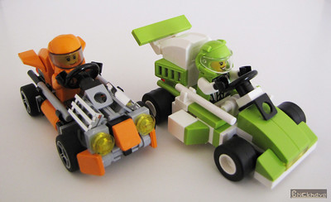
Wanna join?
https://github.com/StabiBerlin/sbb-relevance-test
Duncan.paterson@sbb.spk-berlin.de
Annette.kaufmann@sbb.spk-berlin.de
"Microkarts: Orange versus Lime" by Bricknave is licensed under CC BY-NC-ND 2.0.

Slide 19

Bildersammlung
"Was hier bloß schief gelaufen? #bahn" by elschy is licensed under CC BY 2.0.

